Slide 1

Window Functions in MySQL with Python Integration
M. Tech. – DSML → Team 7
Date: 24th Oct 2020
MySQL – Project Presentation
PRAVEEN MANOHAR G
RAHUL A
RAJESH RAMACHANDER
RANJITH GNANA SUTHAKAR ALPHONSE RAJ

Slide 2
AGENDA
Overview of Window Functions
Database Considered For Case Study
Case Study
MySQL – Python Integration
Learnings & Conclusions
Window Functions in MySQL with Python Integration – Team 7

Slide 3
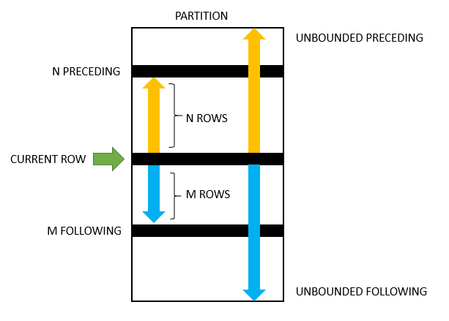
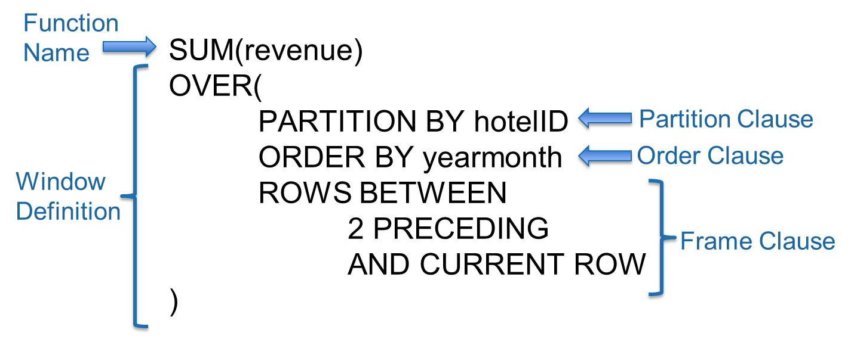
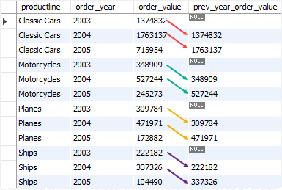
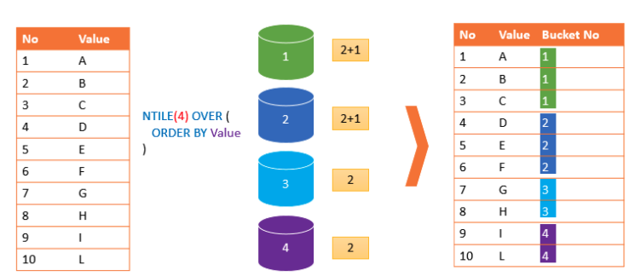
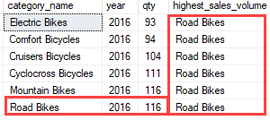
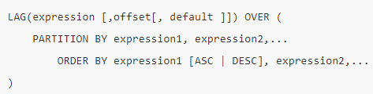
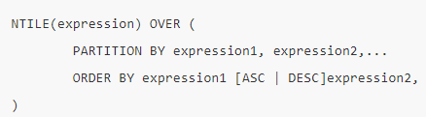
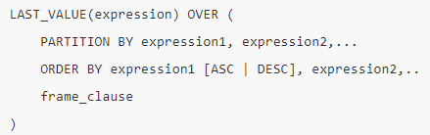
Overview of Window Functions
Window functions allow us to perform calculations against sets or subsets of rows within a query
Parts of a Window Function
Types of Window Functions
Aggregate:
SUM, MIN, MAX, COUNT, AVG,…
Ranking: ROW_NUMBER, RANK, DENSE_RANK, NTILE,…
Distribution/ Analytic functions:
CUME_DIST, FIRST_VALUE, LAST_VALUE, LAG, LEAD, PERCENTILE_CONT, PERCENTILE_DISC, PERCENT_RANK
Running 3 Month Sum
LAG () Function
NTILE () Function
LAST_VALUE () Function
SQL LAG() is a window function that provides access to a row at a specified physical offset which comes before the current row.
NTILE() function is a window function that divides an ordered result set into a number of buckets by a specified expression and assigns an appropriate bucket number to each row.
The LAST_VALUE() is a window function that allows you to obtain the value of the last row in a specified window frame.
Syntax →
Syntax →
Syntax →
Window Functions in MySQL with Python Integration – Team 7

Slide 4
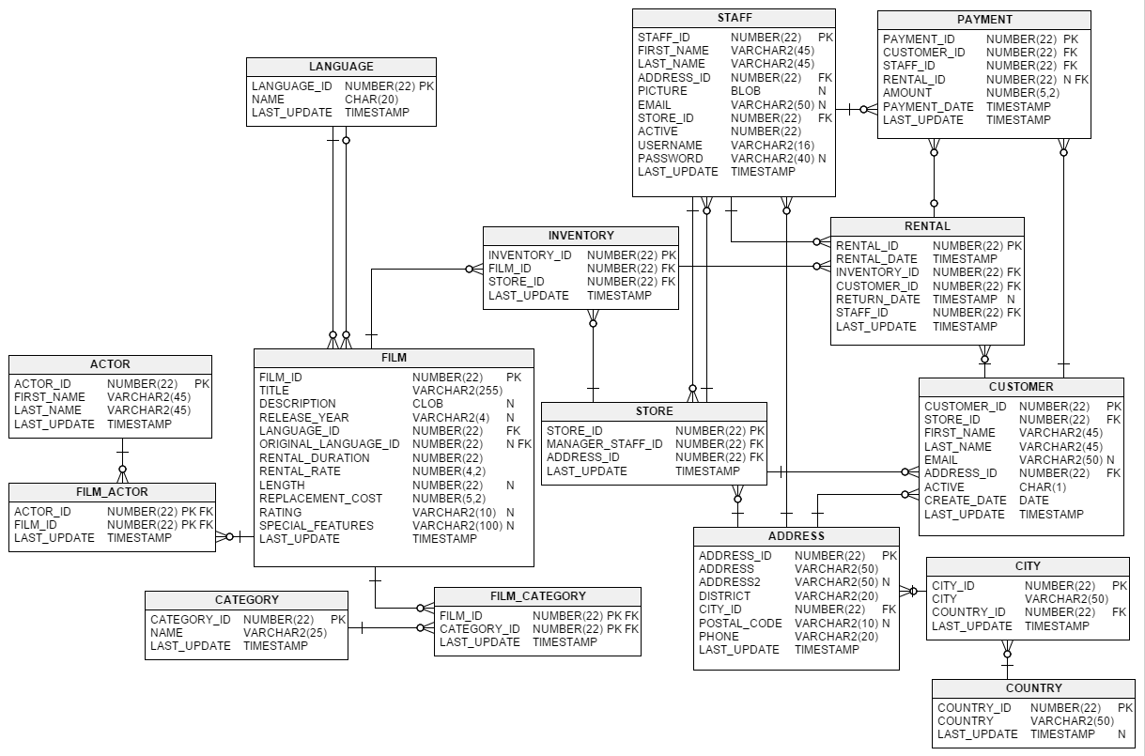
Database Considered For Case Study
Database → SAKILA
Database of a DVD rental store, featuring things like films, actors, film-actor relationships, and a central inventory table that connects films, stores, and rentals along with customer details
No. of tables → 15
Window Functions in MySQL with Python Integration – Team 7

Slide 5
Case Study
Based on SAKILA store database
Window Functions in MySQL with Python Integration – Team 7

Slide 6
Case Study Overview
Business Objective:
The SAKILA DVD store is taking Business Development initiatives. On this the team wants to increase the renting count/ frequency from customers and judiciously stock the stores with newer film titles to maximise revenue gains frugally.
Data Analytics Objective:
Understanding and profiling customers based on rental records in the database
Identify areas of restocking based on rental revenue from the database
Questions to be addressed from data analysis:
What percentage of customers generally hold >1 rentals at a time?
What are the top earning film genres for stocking accordingly?
What is the frequency of payment services offered by each staff? —*
Window Functions in MySQL with Python Integration – Team 7

Slide 7
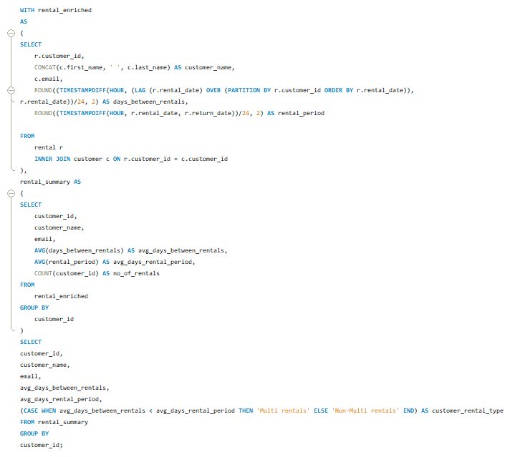
Q1. What percentage of customers generally hold >1 rentals at a time?
Customer profiling based on average days between rentals and average rental period
Querying Steps:
Calculate the time duration between successive rentals by each customer using the LAG function from the ‘rental’ table
Calculate the time duration of each rental by taking the difference between rental_date and return_date
For each customer calculate the average duration between rentals and average rental period
Based on the average fields identify customers who generally rent a second title before returning the first one (Multi rentals)
IF [avg_days_between_rentals < avg_days_rental_period], then classify the customer as ‘Multi rentals’ customer ELSE ‘Non-Multi rentals’
Window Functions in MySQL with Python Integration – Team 7

Slide 8
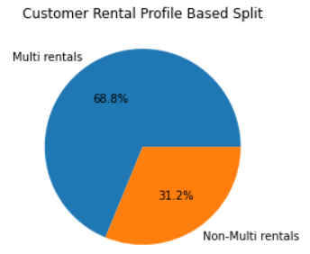
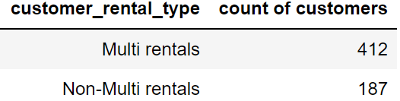
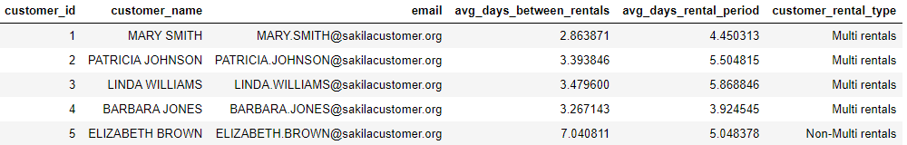
Q1. What percentage of customers generally hold >1 rentals at a time? (Cont’d…)
Customer profiling based on average days between rentals and average rental period
Note:
‘Multi rental’ customer → Customers who generally rent a second title before renting the first one
‘Non-Multi rental’ customer → Customers who generally rent one title at a time and return the same before the next rental
Observations:
There are 599 customers in the SAKILA database
~69% of them in general hold multiple rentals at a time
A greater percentage of customers generally look to hold multiple rentals at a time, at ~69% (412 out of 599)
Business suggestion:
The ‘Non-Multi rentals’ customers can be potentially be reached with some offers to rent multiple films to increase rental frequency
Window Functions in MySQL with Python Integration – Team 7

Slide 9
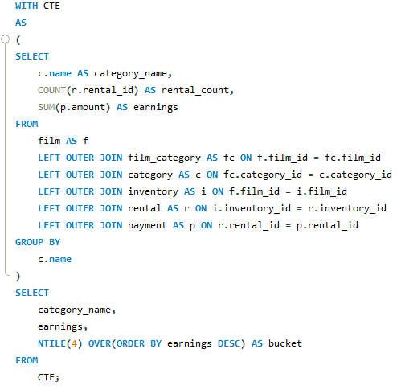
Q2. What are the top earning film genres for stocking accordingly?
Bucket film genres into 4 levels of rental earnings from the data
Querying Steps:
Build a master table by joining tables film, film_category, film, rental, inventory and payment
Calculate total earnings and count of films per genre
Classify film genre in 4 quartiles based on the earnings using the NTILE() function
Window Functions in MySQL with Python Integration – Team 7

Slide 10
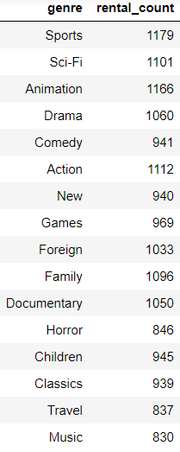
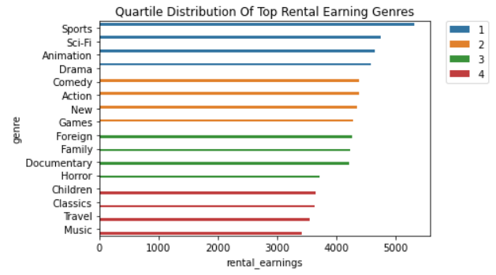
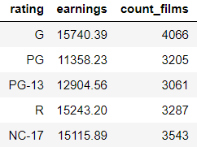
Q2. What are the top earning film genres for stocking accordingly? (Cont’d…)
Bucket film genres into 4 levels of rental earnings from the data
Observations:
15 genres are classified into 4 buckets
Top quartile consist of Sports, Sci-Fi, Animation & Drama
It is interesting to see that Animation is in first quartile and Children is in the last quartile, probably the rentals for children are from the animation genre
Business suggestion:
Discounts can be offered on films from the lower quartile genres
Offer bundled genre deals between extreme quartile genres
Quality of titles to be increased from lower quartiles
Window Functions in MySQL with Python Integration – Team 7

Slide 11
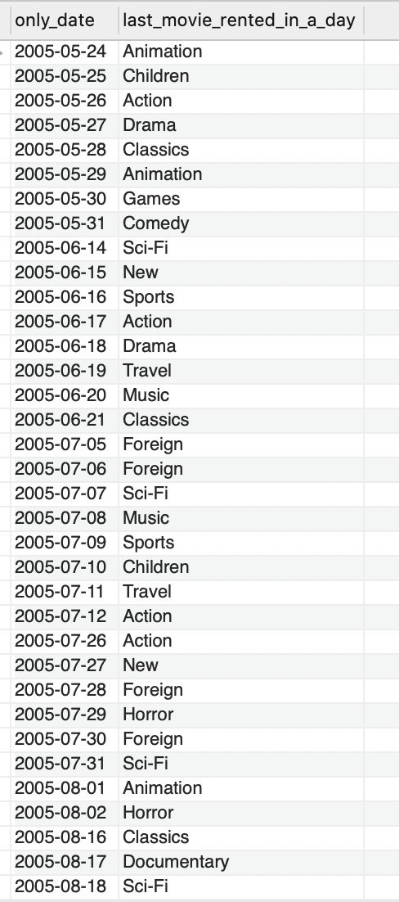
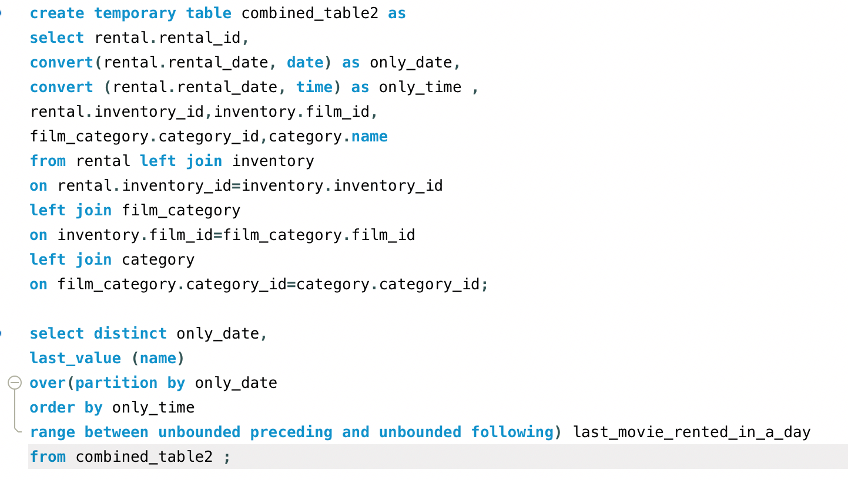
Q3. What is the genre of the last movie rented in a day?
-- Used 4 Table join on rental , inventory , film_category, category tables
Window Functions in MySQL with Python Integration – Team 7

Slide 12
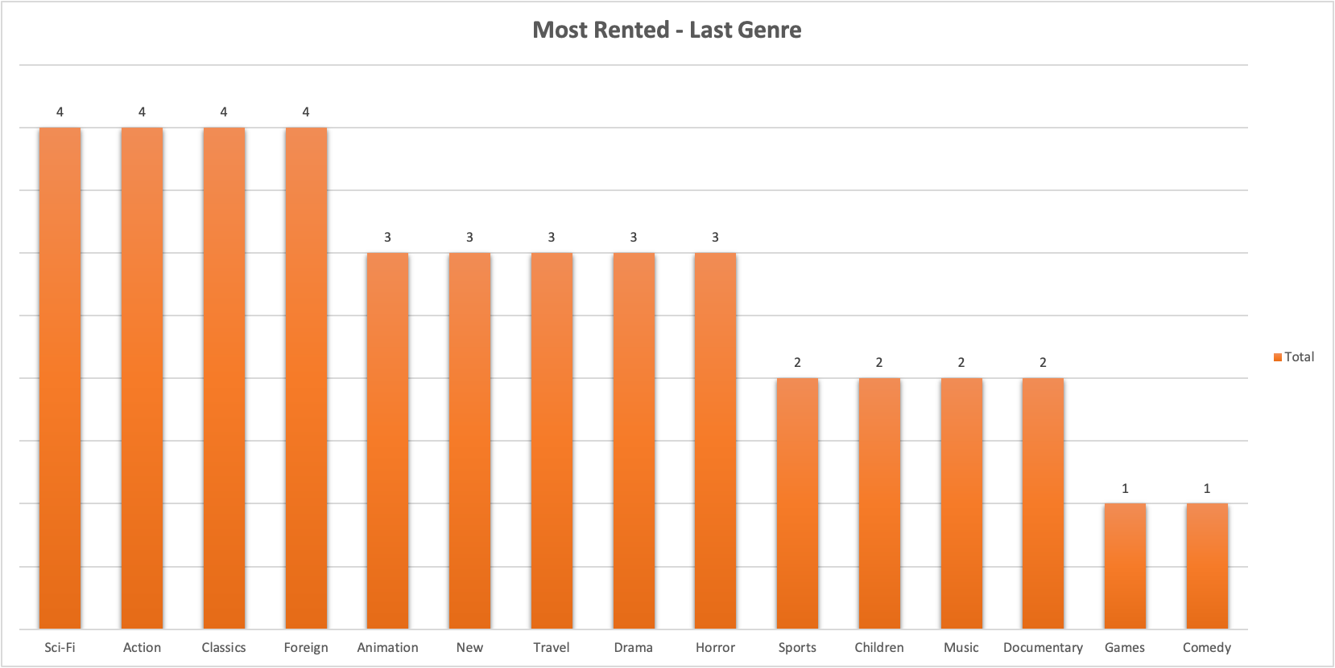
Q3. What is the genre of the last movie rented in a day?
Observations:
The last genre rented in a day by customers show a trend of their preference.
Business suggestion:
The business can stock up the store with the most rented last genre, to meet the demand for the customers on the following day
Target customers with advertisements according to their last rented genre trend
These related movies in the same genre have the highest chance of matching with the interest in customer, hence providing relevant offer or discount could increase the sales
Window Functions in MySQL with Python Integration – Team 7

Slide 13
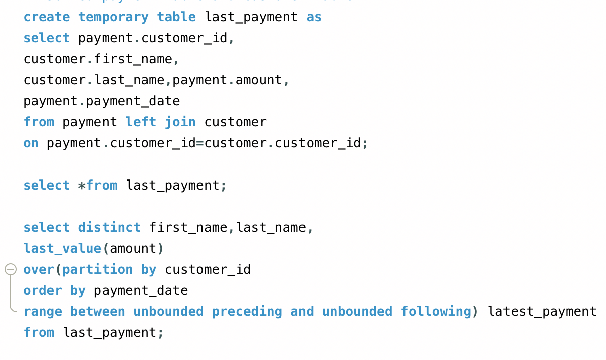
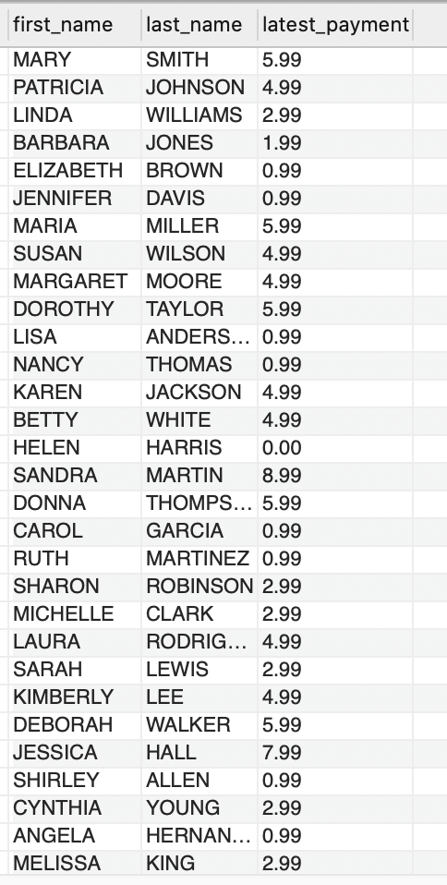
Q4. What is the last/ latest payment of customer from the given data?
-- Joined payment table and customer table and applied Last_Value()
Window Functions in MySQL with Python Integration – Team 7

Slide 14
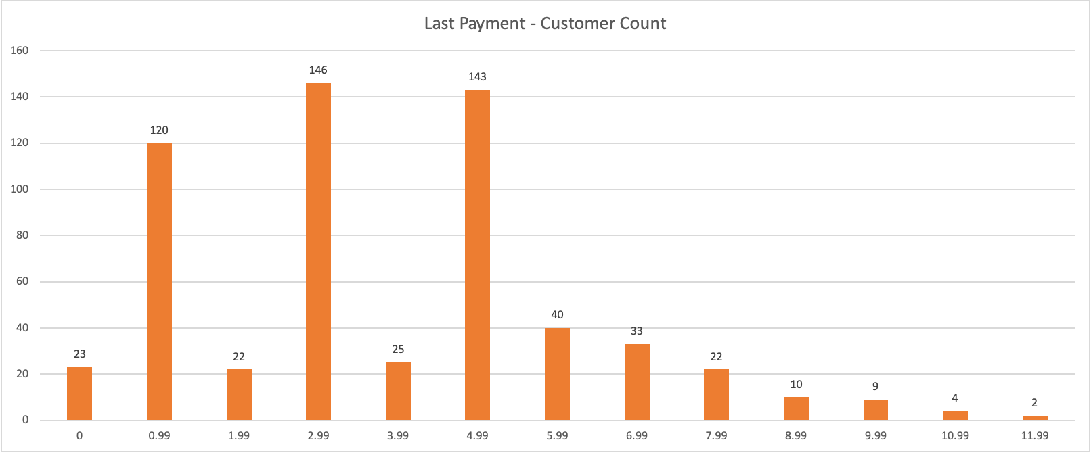
Q4. What is the last/ latest payment of customer from the given data? (Cont’d…)
Observations:
The last payment by the customers shows a trend of their interest based on their payment amount
Business suggestion:
The business can narrow down on the last payment details and arrive at the most rented films
The business can consider segmenting the price range of other films within the range of the most paid categories
Target customers with similar price segmented films and offer discounts to films that fall under the least purchased price segment
Window Functions in MySQL with Python Integration – Team 7

Slide 15
MySQL – Python Integration
Exploring Capabilities For Data Analytics
Window Functions in MySQL with Python Integration – Team 7

Slide 16
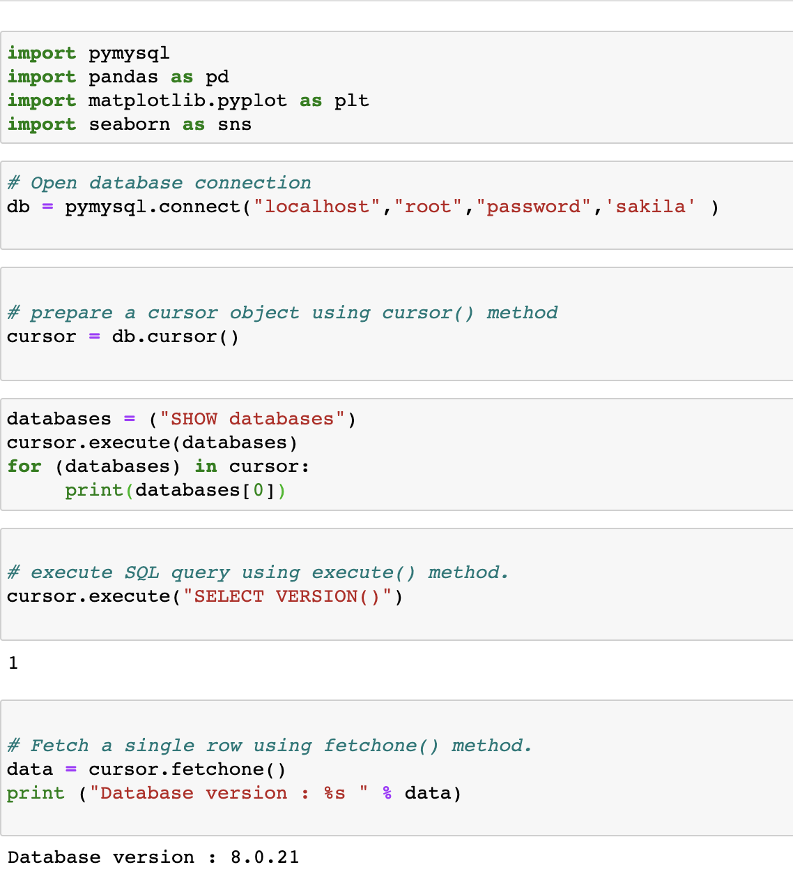
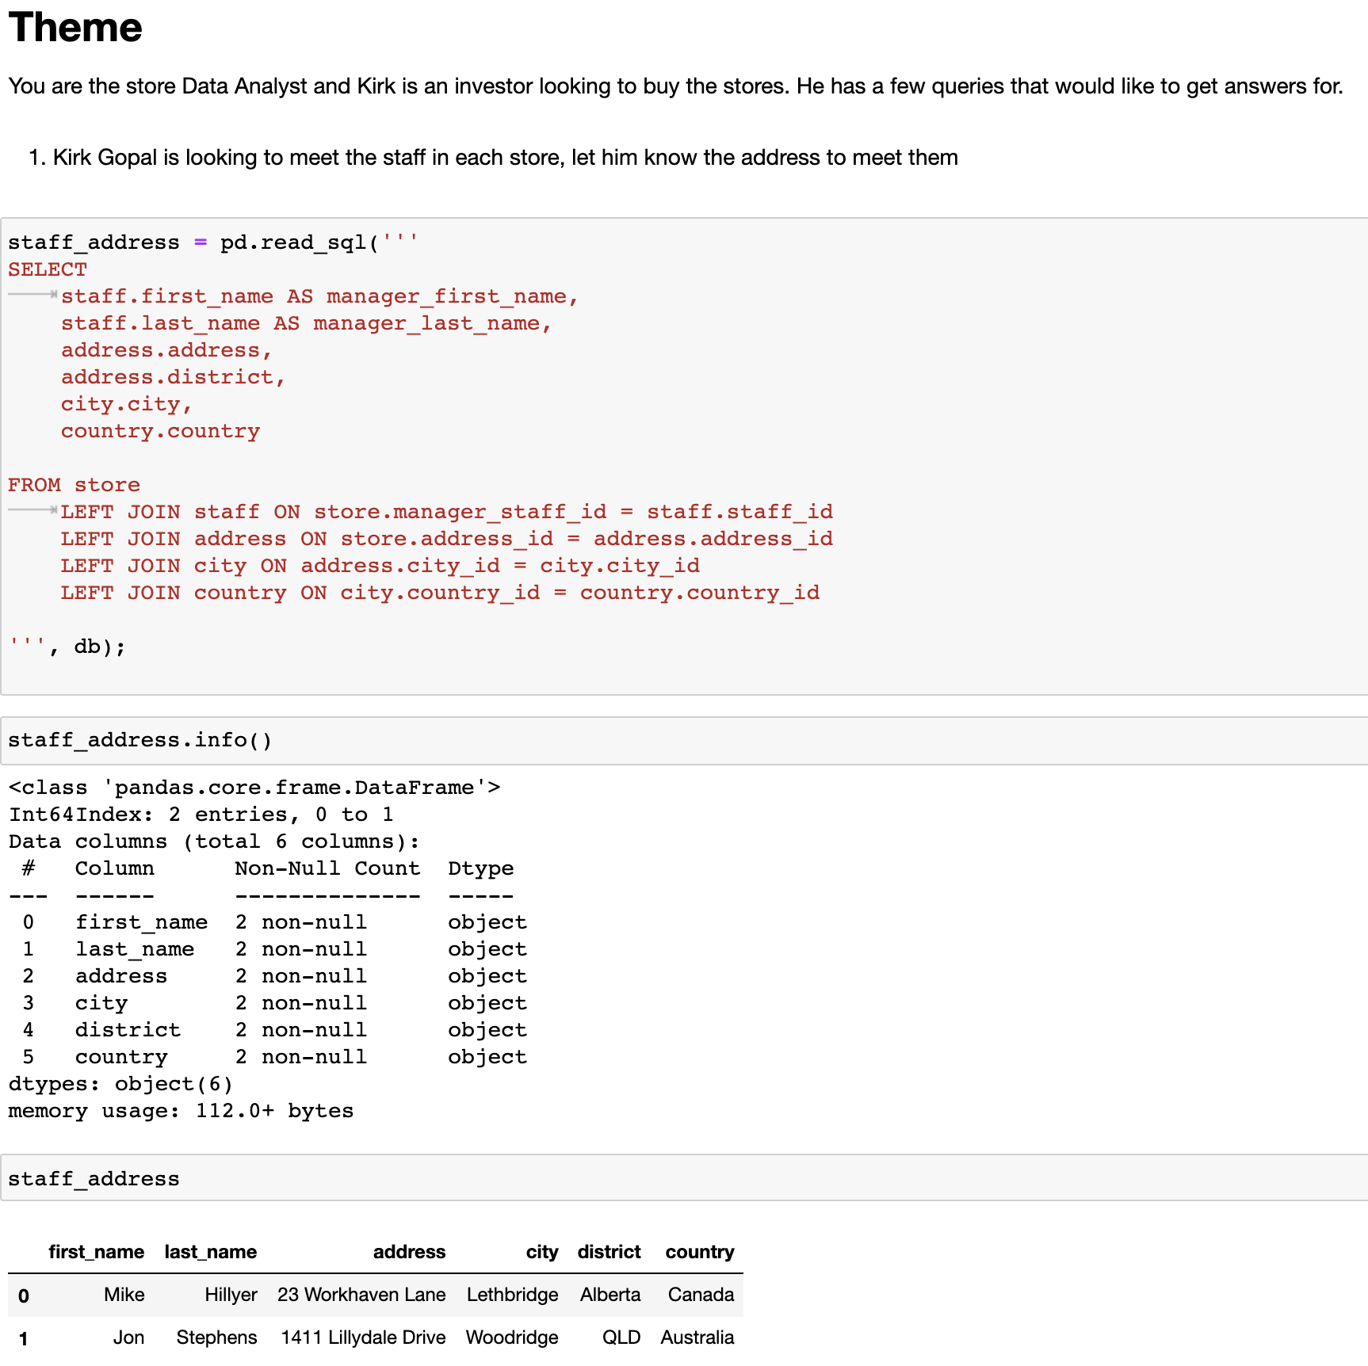
Python and SQL Connectivity
Execute
query using Pandas
Panda DataFrame
Though we choose 'pymysql,' there are multiple other libraries available which has similar capabilities such as 'MySQLdb' etc.
The connectors allow pass-throughs where the queries can be directly written and executed .
Cursor fetch commands returns tuple.
Window Functions in MySQL with Python Integration – Team 7

Slide 17
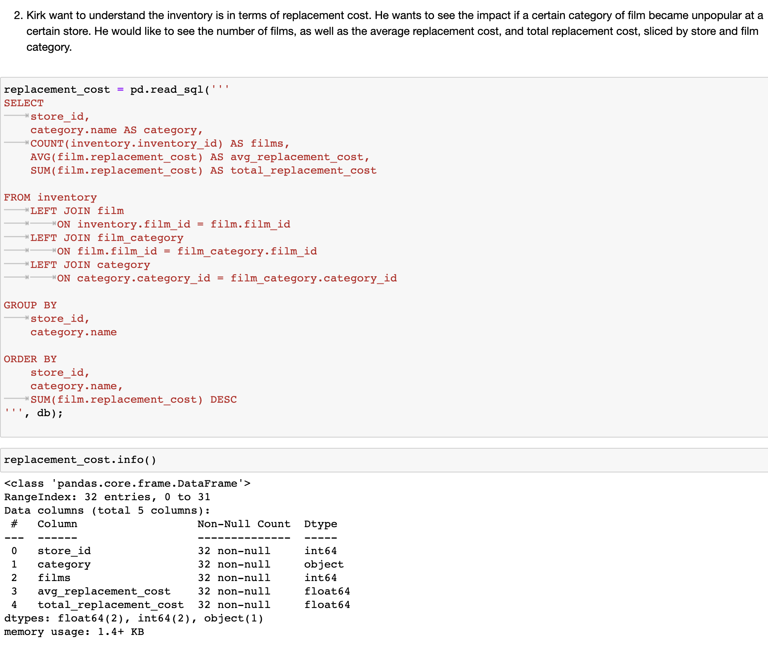
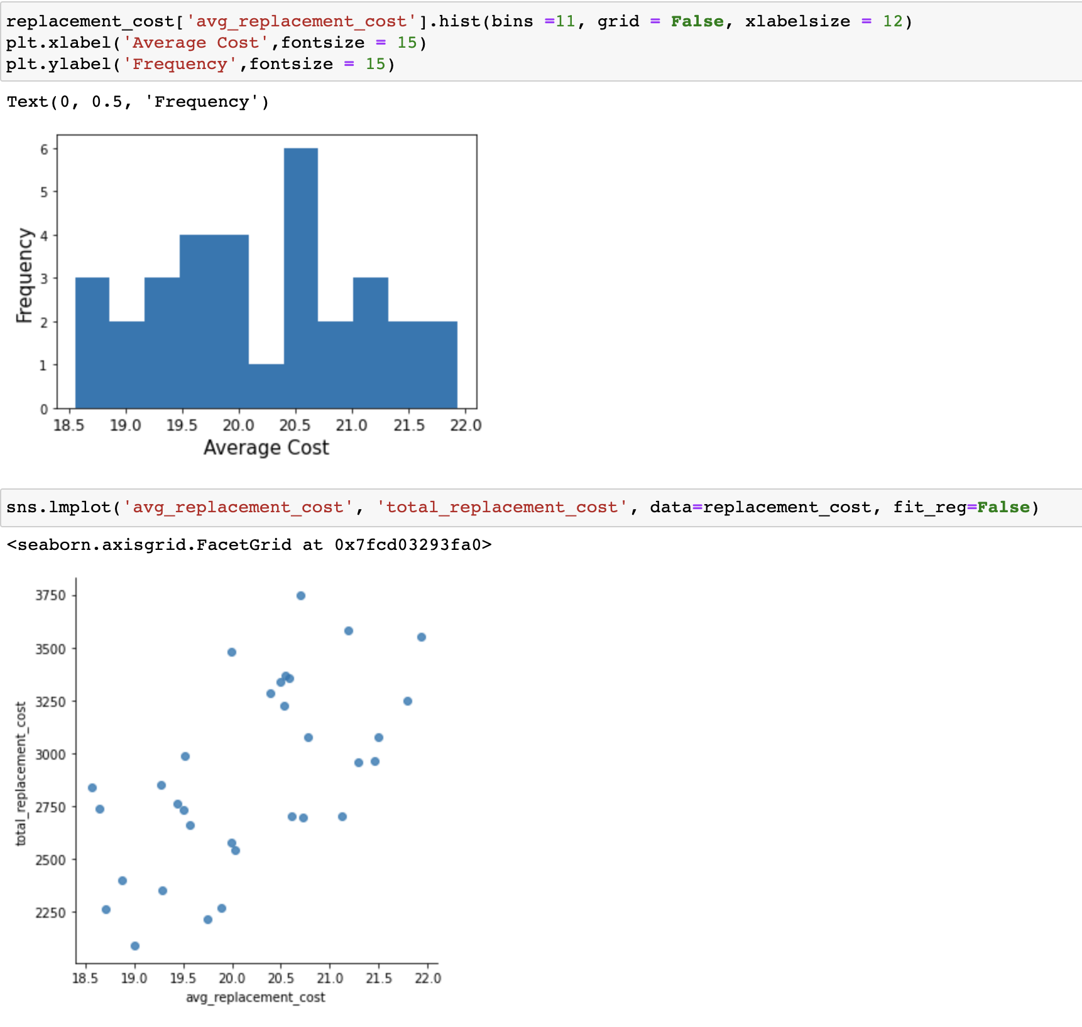
A Multiple Join Query - Sample 2
Once we obtain the result set as a data frame, we can use seaboard and or plotly from matplotlib to generate figures.
The experience of developing and executing SQL queries in Jupyter notebook was seem-less and came across as a good alternative to directly using MySql workbench.
Window Functions in MySQL with Python Integration – Team 7

Slide 18
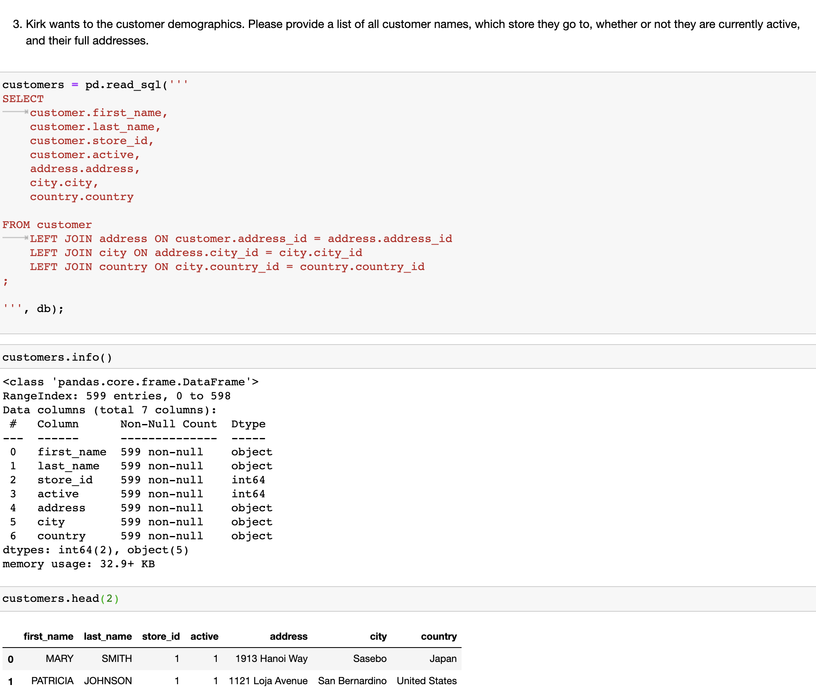
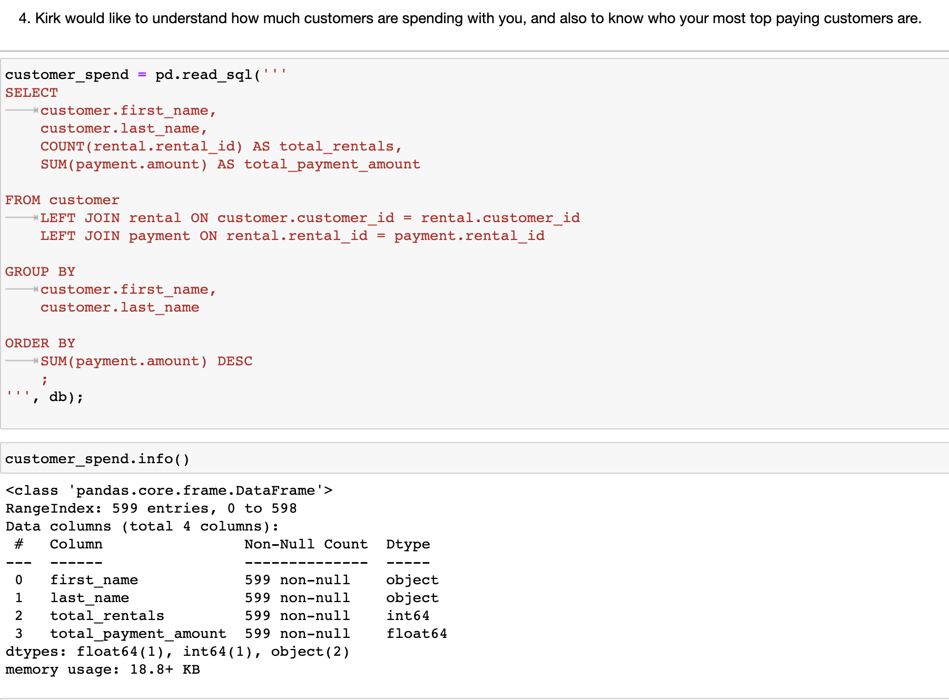
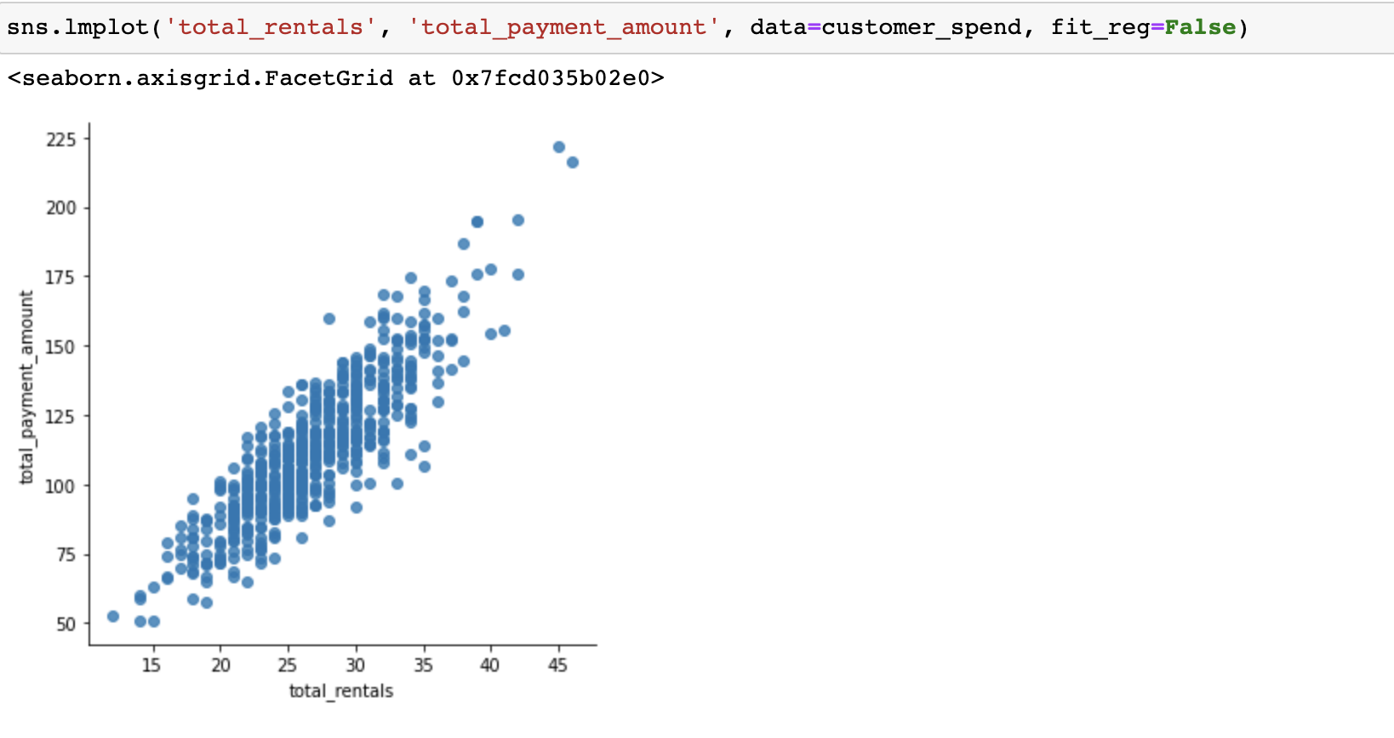
A Multiple Join Query - Sample 3 & 4
Multi join in-depth queries can be built just how it is done on, say, MySql workbench.
In query 4, a visual inference can be made that the bulk of customers have rented between 20 and 35 rentals.
Window Functions in MySQL with Python Integration – Team 7

Slide 19
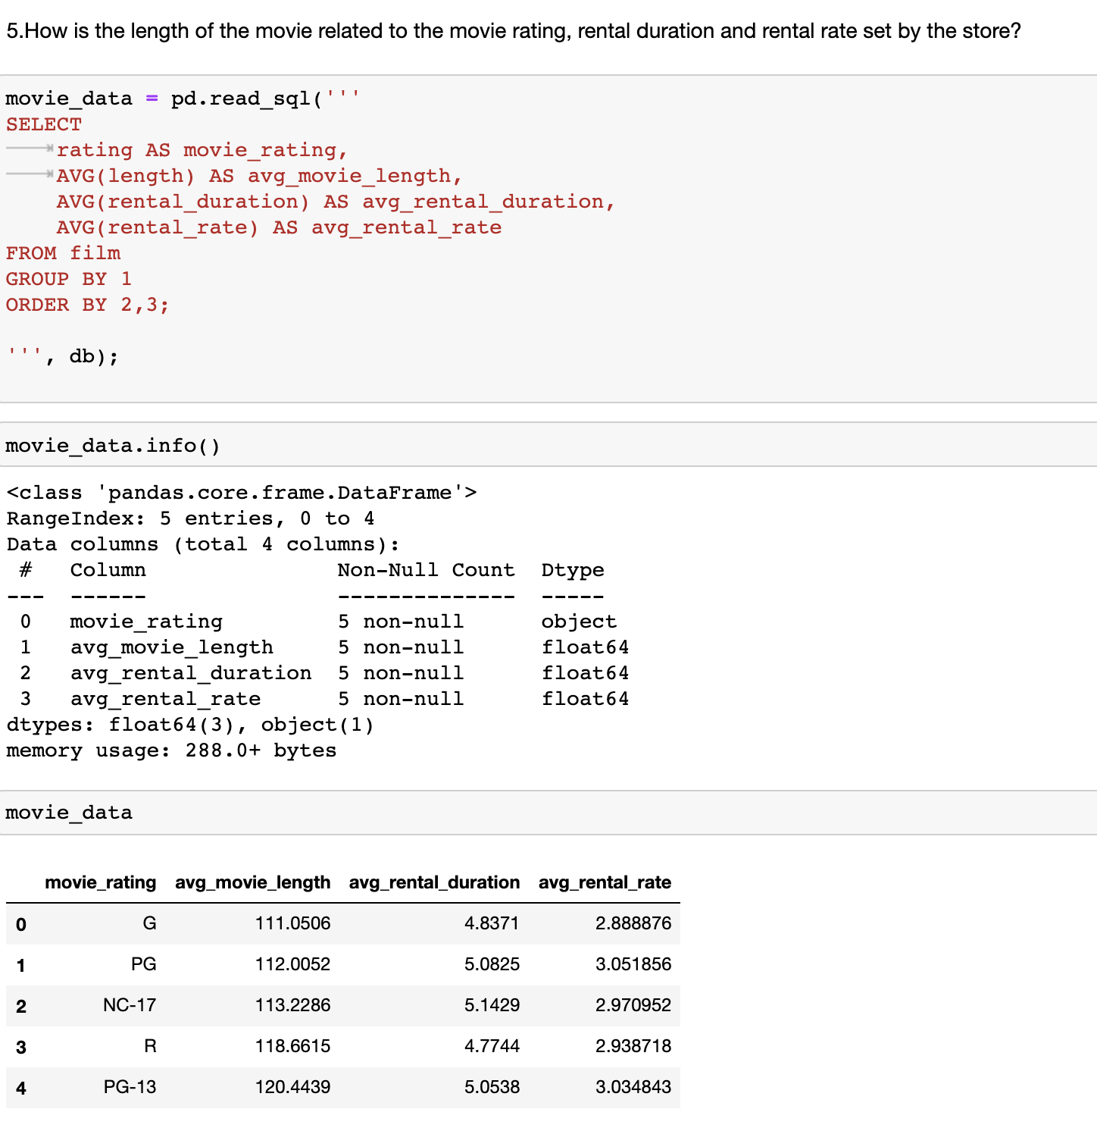
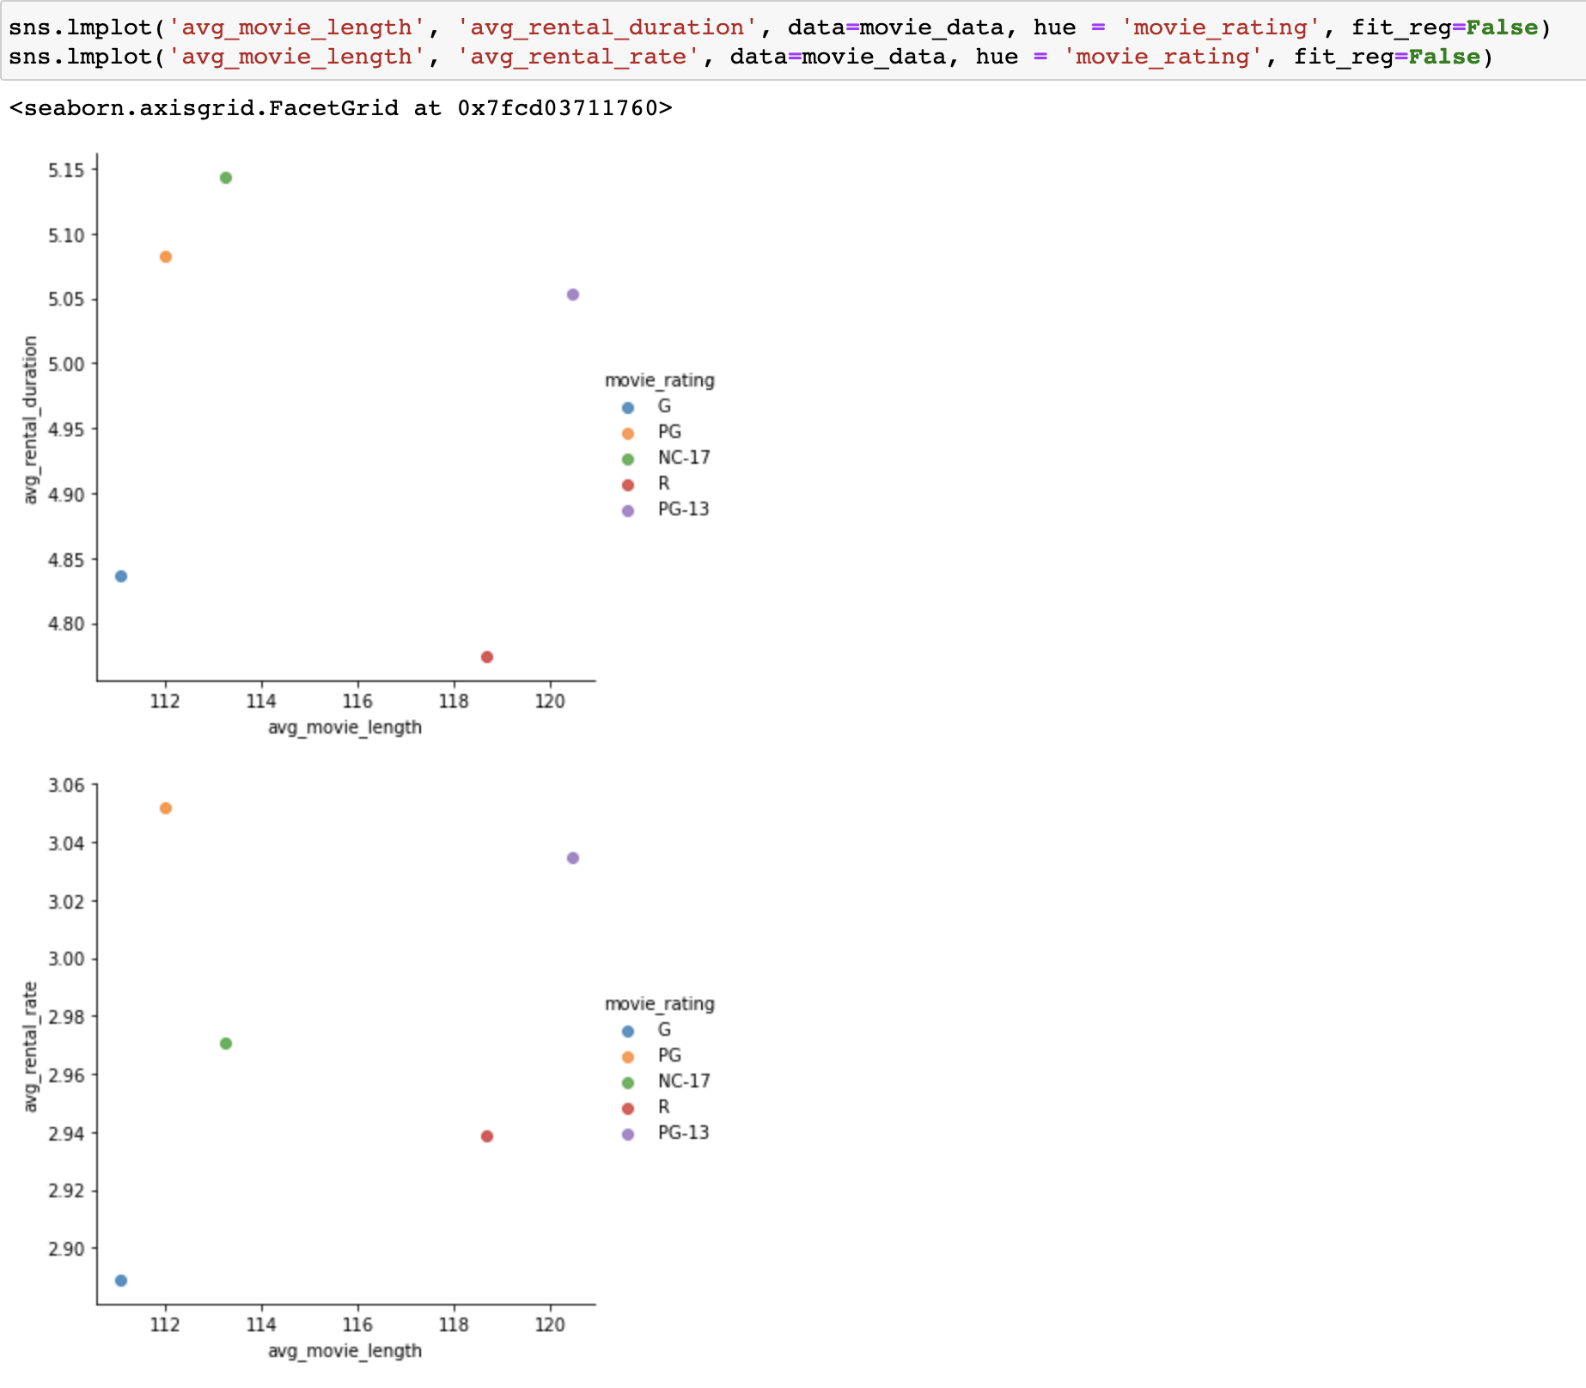
Another Query - Sample 5
Movie length and rental duration do not seem to show any direct correlation.
Similarly, movie length and rental rates across categories do not seem to show any visual correlation.
Window Functions in MySQL with Python Integration – Team 7

Slide 20
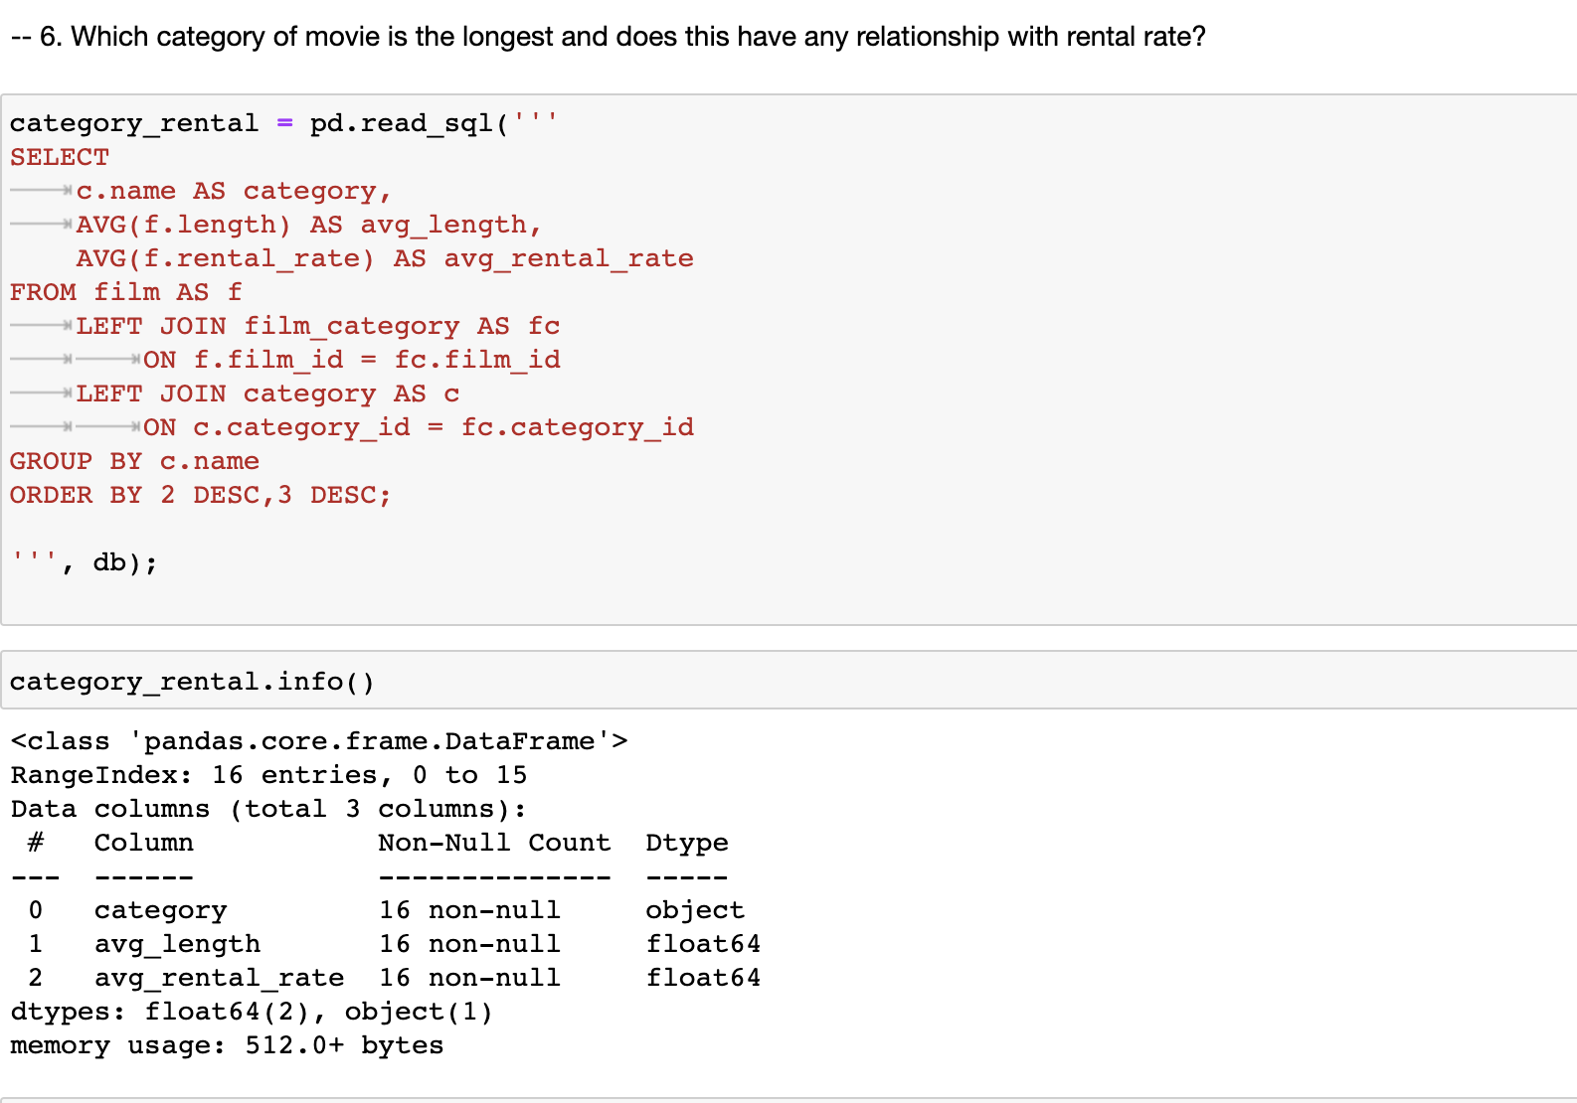
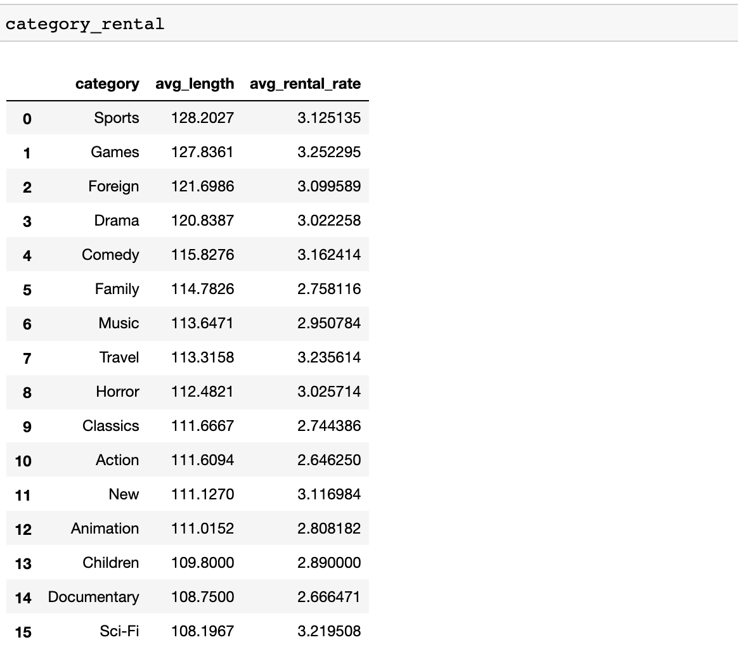
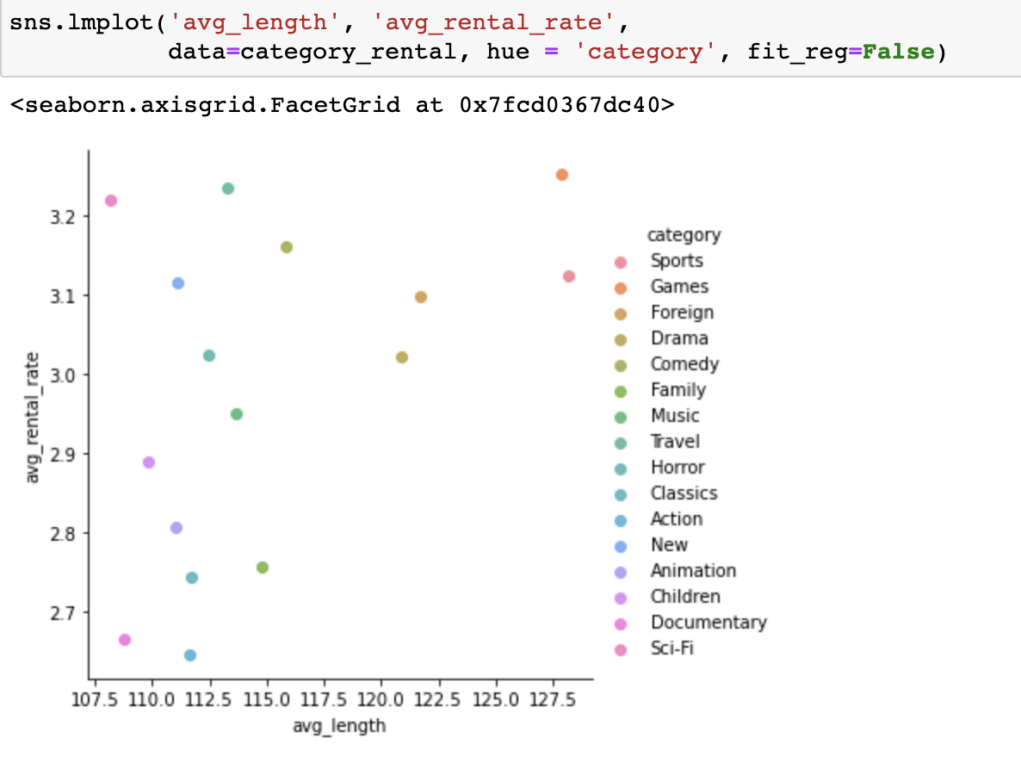
Another Query - Sample 6
Sports category movies seem to be the most prolonged duration amongst the movie categories on average.
Here again, there is no clear visual correlation between rental duration and rate.
Window Functions in MySQL with Python Integration – Team 7

Slide 21
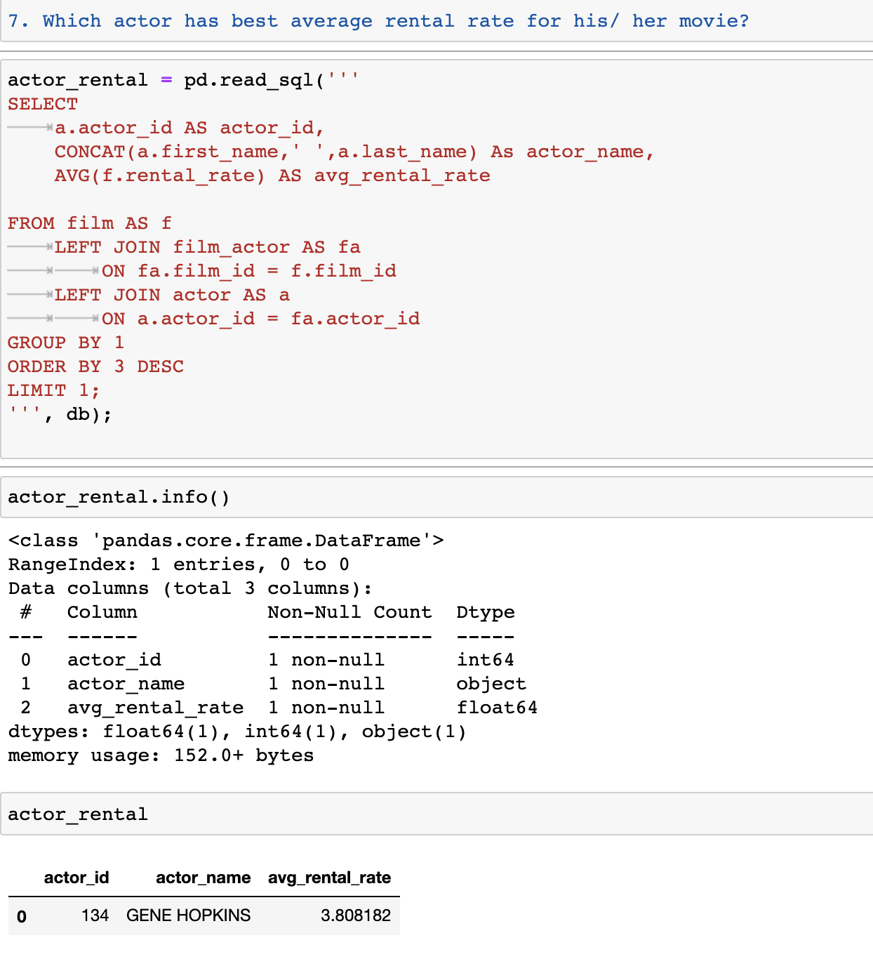
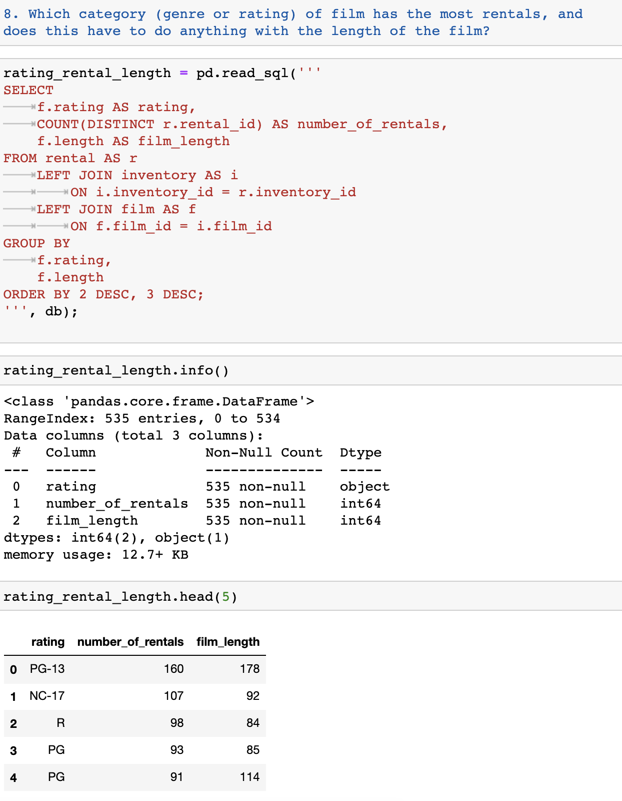
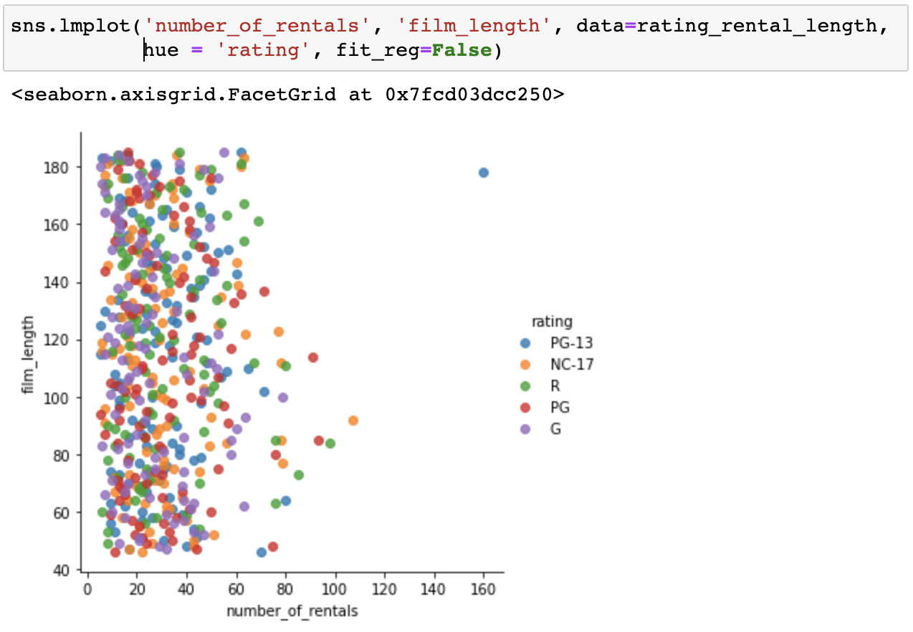
Another Query - Sample 7 & 8
Query 8 outcome, when rendered on the Seaborn plot, brought out an interesting data point that showed that the film's length does not have a direct bearing on the number of rentals.
Window Functions in MySQL with Python Integration – Team 7

Slide 22
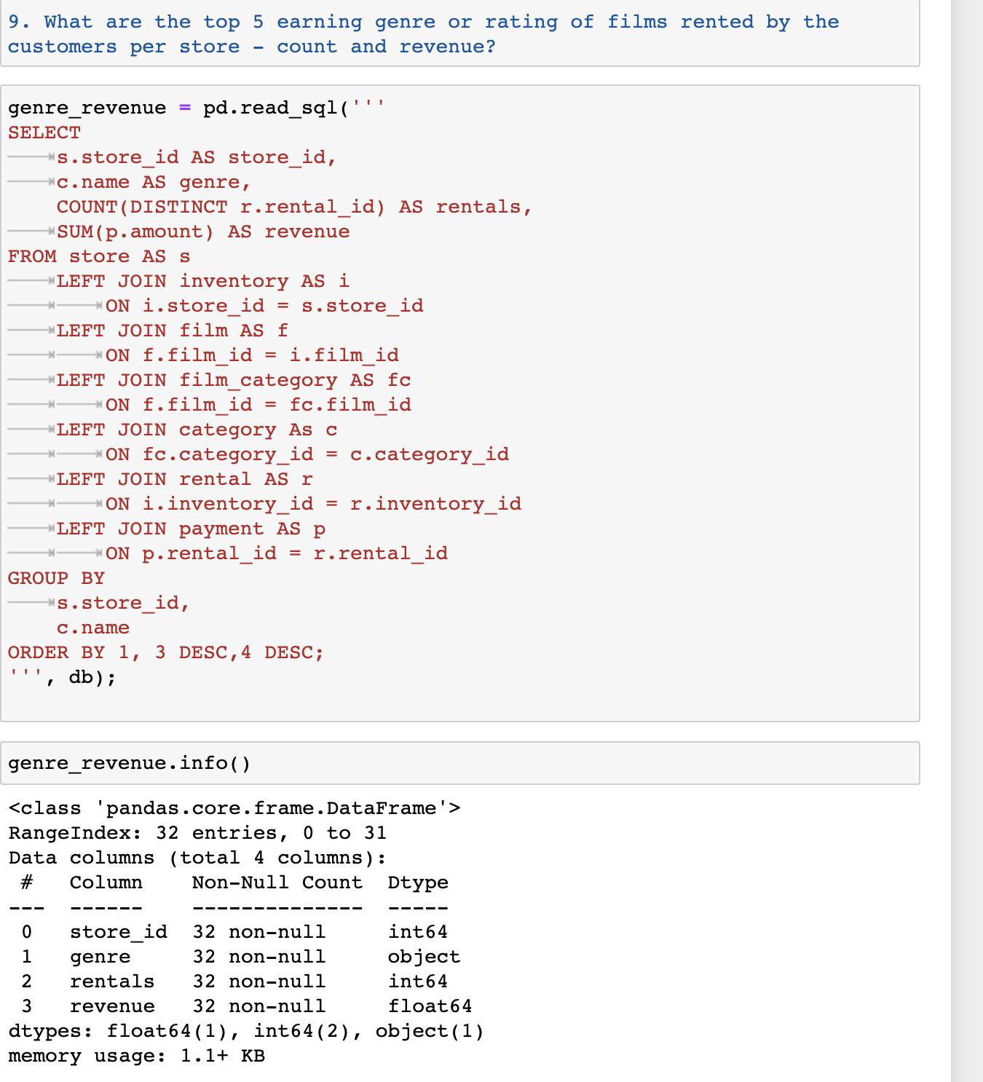
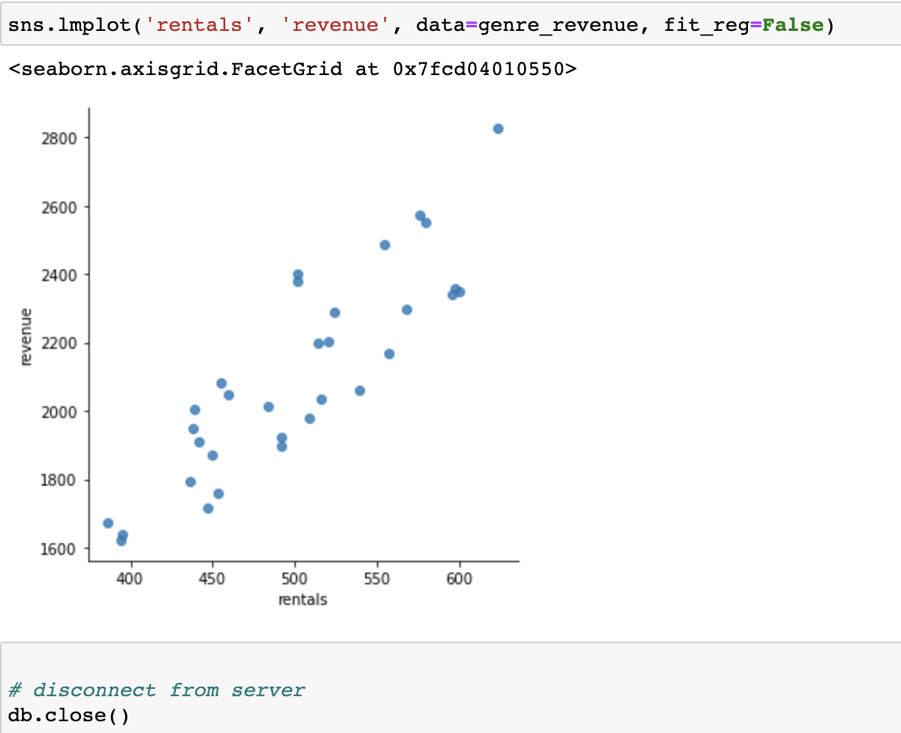
Another Query - Sample 11
The number of rentals increased revenue for the stores, which was expected
Technically, using Python DB connectors made
Writing queries seamless and more accessible without loss of information
Gave more valuable integration options with other python libraries such as pandas, seaborn, math plot lib.
Window Functions in MySQL with Python Integration – Team 7

Slide 23
Learnings & Conclusions
Data Analysis Insights
Profiling customers is very important for any business to sustain and improve its top line and bottom line →
Classifying the customers based on their DVD rental behavior will be insightful to the SAKILA store business team, to create opportunities to delight the customer base with quality and cost of service, and would make acquiring new customer easy as current customers will become advocates. This would further reduce customer acquisition cost.
Deciding on an area to invest in an active business to maximize and accelerate returns is very key. Decisions basically could make or break a business →
Investing in newer film titles is very critical for the SAKILA stores to cater to the ever growing needs of its customers. On this, understanding the genres or buckets of genres of films with their respective rental revenue generated will make the decision more data driven.
Insights generally required by investors interested in the store →
Information on customer demographics, store preferences, inventory value and potential inventory replacement liabilities will be critical
Other possibilities →
Further insights like understanding the lead actors from the films with high demand, ratings of films of with maximum rental returns, understanding frequency usage of payment or other applications, etc…could be invaluable to not only maximize returns and grow the business, but also make the service offered a delight to the customers, bringing in tangible and intangible benefits
Tools & Functions → Window Functions & MySQL – Python Integration
Window functions like LAG(), NTILE() and LAST_VALUE are very useful to derive insights from data partitioned without any aggregations
Python and MySQL integration comes in handy using libraries like PYMYSQL, MySQLdb, etc..
Querying data using SQL and writing the output to a pandas dataframe makes it apt to flex the capabilities of python on further analysis or visualization of the data
Getting to answers to real world questions using data can be catalyzed using the power of cross platform integration
Window Functions in MySQL with Python Integration – Team 7
Notes:
Data Insights:
Classifying the customers based on their DVD rental behavior will be insightful to the SAKILA store business team, to create opportunities to delight the customer base with quality and cost of service, and would make acquiring new customer easy as current customers will become advocates. This would further reduce customer acquisition cost.
Investing in newer film titles is very critical for the SAKILA stores to cater to the ever growing needs of its customers. On this, understanding the genres or buckets of genres of films with their respective rental revenue generated will make the decision more data driven.
Information on customer demographics, store preferences, inventory value and potential inventory replacement liabilities will be critical
Further insights like understanding the lead actors from the films with high demand, ratings of films of with maximum rental returns, understanding frequency usage of payment or other applications, etc…could be invaluable to not only maximize returns and grow the business, but also make the service offered a delight to the customers, bringing in tangible and intangible benefits

Slide 24
Thank You!
Project Team
PRAVEEN MANOHAR G
RAHUL A
RAJESH RAMACHANDER
RANJITH GNANA SUTHAKAR ALPHONSE RAJ
Github link to codebase
https://github.com/RajeshRamachander/mysqlpython

